Slide 1
Interrupted time series
Alison Gemmill
June 8, 2023
Berkeley Formal Demography Workshop
(Some slides borrowed from Tim Bruckner at UC Irvine
And Liz Stuart at Johns Hopkisn)

Slide 2




Rationale
Population is the unit of interest
Use of time series data (monthly, weekly, etc.)
Interruption has a well-defined time of onset
Policy evaluation
Acute population shocks (COVID-19, Great Recession, Terrorist attacks)
Strong casual inference/natural experiments
Denominators are not available
No comparison group within the population exists (although ITS can also be used with comparison groups)

Slide 3
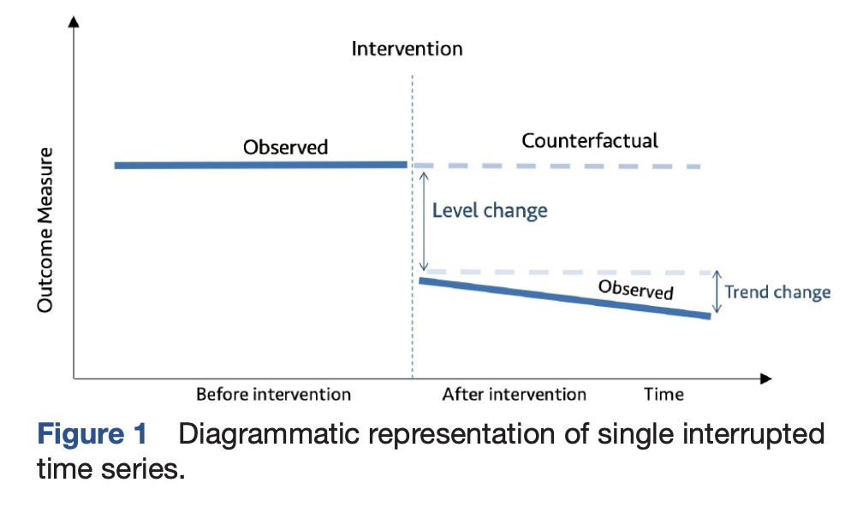
General approach of an ITS design
This method allows you to compare observed values of preterm birth with counterfactual values extrapolated from patterns in the pre-shock data
Source: Hategeka et al. (2020), BMJ Global Health

Slide 4
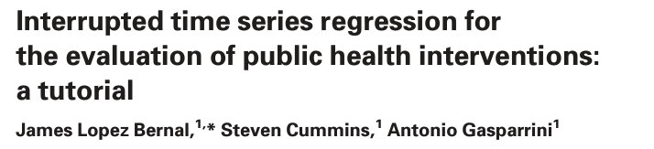
The nuts and bolts
Bernal et al. 2017 IJE

Slide 5
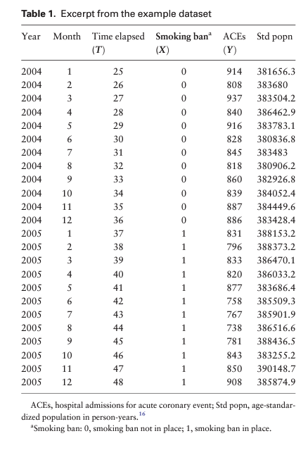
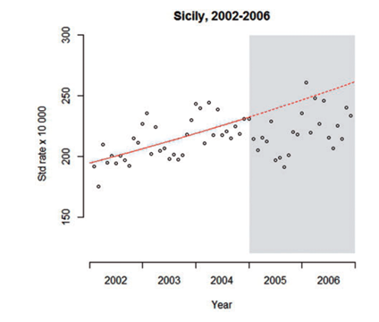
Bernal et al. 2017 IJE

Slide 6

Basic ITS approaches: Segmented regression
β₀ represents the baseline level at T = 0
β₁ is interpreted as the change in outcome associated with a time unit increase (representing the underlying pre-intervention trend)
β₂ is the level change following the intervention and β₃ indicates the slope change following the intervention (using the interaction between time and intervention: TX_{t⁠})
Bernal et al. 2017 IJE

Slide 7
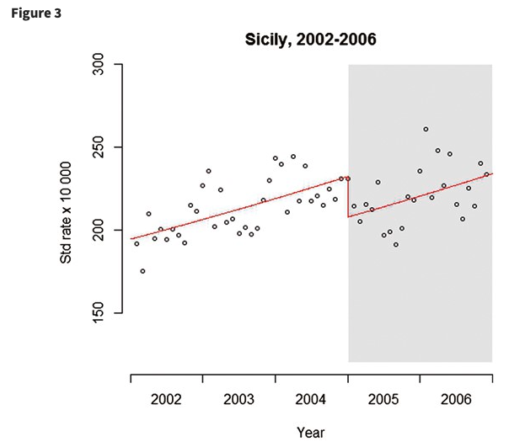
Example: Segmented regression results
Pitfalls
Does not account for seasonality or other types of autocorrelation
May not capture short-term changes or fluctuations after interruption
Bernal et al. 2017 IJE

Slide 8
Importance of accounting for autocorrelation in time series data
Patterns in outcome variable may include trend, seasonality, and other autocorrelation “signatures”
Failure to identify and control for autocorrelation in the pre-intervention period often leads to falsely attributing an “effect” to the intervention itself
Or, leads to artificially precise standard errors
Strengthens causal inference (especially when there’s no comparison group)

Slide 9
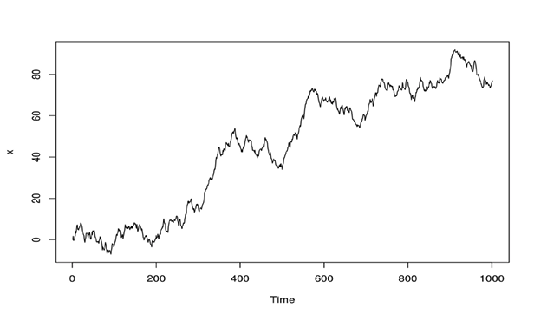
Trend

Slide 10
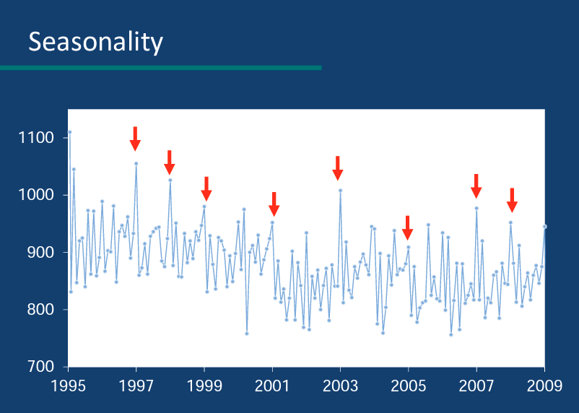

Slide 11
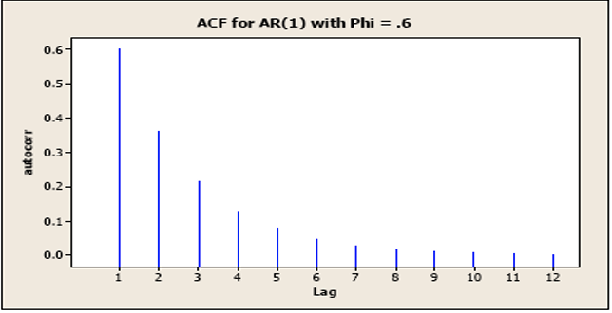
Memory

Slide 12
Logic of ITS that accounts for autocorrelation
Identify autocorrelation of an outcome (Y) before intervention to derive statistically expected values of Y after intervention
Counterfactual is derived from the history of Y
Earlier values of Y are used to remove patterns, so that expected values of residuals = 0
Intervention (X) may cause Y only if it predicts Y better than the history of Y itself
Granger causality; conservative

Slide 13
Generating counterfactuals that account for autocorrelation

Slide 14
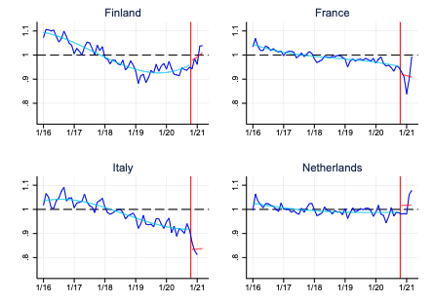
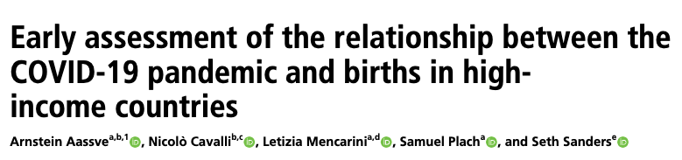
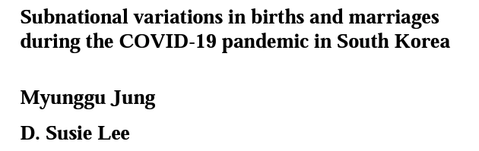

1. Yearly time trends + month fixed effects
a_{m} denotes fixed effects of month m
COVID19 is a dummy variable equal to 1 from November 2020 and 0 otherwise
𝑇𝑖𝑚𝑒_{𝑡} refers to the month and the year; 𝛾^{𝑖} are estimates of the linear, quadratic, and cubic time trends
Coefficent 𝛽 estimates the average changes in the GFRs or GMRfs between the pre-pandemic and during-pandemic periods after controlling for temporal trends and seasonality.

Slide 15

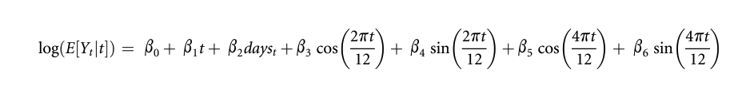
2. Adding Fourier terms
Modeled monthly counts of abortions (Y_{t}) using a GLM w/ log link and Poisson distribution
Time t for each month captures trends
Days_{t} is a term for number of days that clinic was open in month t
Rest of terms are Fourier terms used to capture seasonality (pairs of sine and cosine functions)

Slide 16
3. Adding flexible spline functions
Uses a number of different polynomial (most commonly cubic) curves that are joined smoothly end-to-end to cover the full period
In generating the spline basis, it is necessary to decide how many knots (join-points) there should be, which governs how many end-to-end cubic curves will be used and therefore how flexible the curve will be
Too few → fail to capture the main long-term patterns closely
Too many → can result in a very ‘wobbly’ function which may compete with the variable of interest to explain the short-term variation of interest, widening confidence intervals of relative risk estimates
Bhaskaran et al. 2013

Slide 17
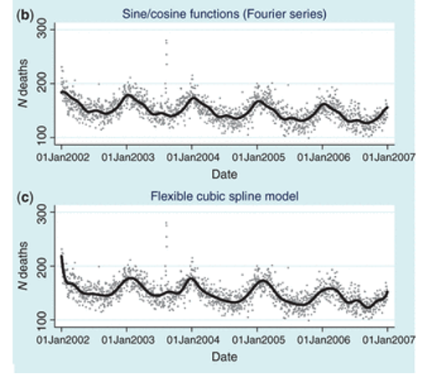
More on Fourier and Spline functions
 | Fourier | Splines
Pros | Uses few parameters; models long-term patterns smoothly | Can capture seasonal patterns in a way that is allowed to vary from one year to the next
Cons | The modeled seasonal pattern is always forced to be the same from one year to the next, which may not reflect the data well | Need to balance having too few or too many join-points (no consensus on optimal # of join-points); could miss short-term fluctuations or perturbations
Bhaskaran et al. 2013

Slide 18
4. ARIMA transfer functions (models using Box-Jenkins routines)
Detect patterns in temporal data
Seasonality, trend, plateaus, spike and decay, etc.
ARIMA
Autoregressive (AR): captures the tendency for high or low values to be remembered into the subsequent time periods
Integrated (I): characterizes non-stationarity (e.g., secular trend, strong seasonality)
Moving average (MA): similar to an AR term in that it captures “memory” of a high or low value but disappears much more quickly than an AR and is often characterized as an “echo.”

Slide 19
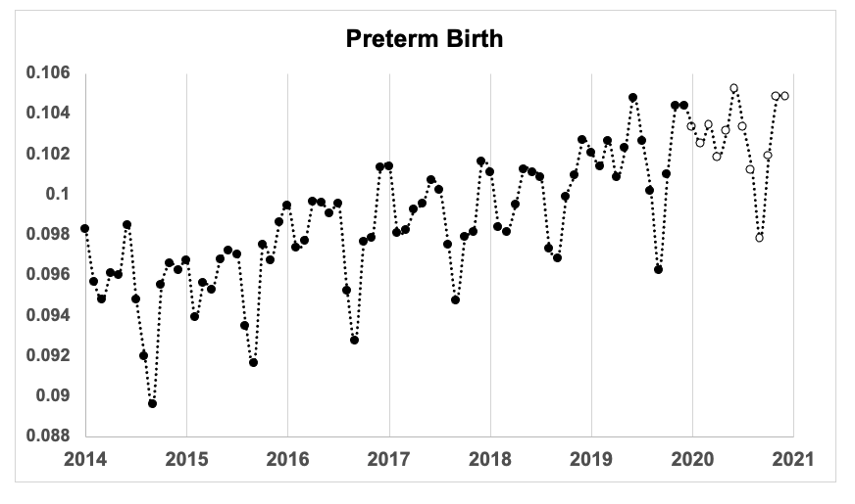

Slide 20
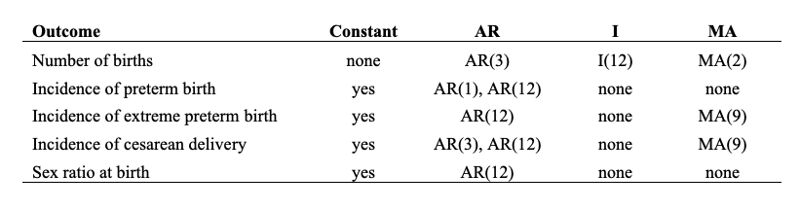
ARIMA models for outcomes

Slide 21
ARIMA models for outcomes
All outcomes, except sex ratio at birth, contained additional patterning beyond a seasonal/calendar month effect (i.e., AR at lag other than 12 or I term other than 12)
Gemmill et al. 2022

Slide 23
Considerations

Slide 24
Always check residuals for temporal autocorrelation
Investigate Autocorrelation Function (ACF) and Partial Autocorrelation Function (PACF)
ACF and PACF answer the following questions:
Is the observed time series white noise (random)?
Is an observation related to adjacent observations or other observations?
And for ARIMA approaches: Can time series be modeled with an AR, MA, or I term?

Slide 25
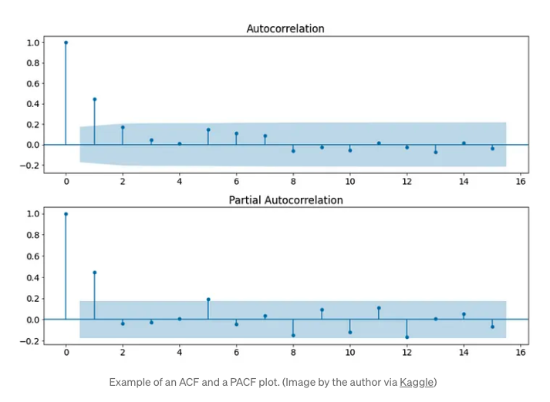
AR(1) process:
Geometric decay in ACF plot
In PACF, cuts off at lag 1
Lots of decision rules and testing
Auto.arima() functions in R and Stata (algorithm based)

Slide 26
Number of observations
Depends on method
For ARIMA, at least 50 pre-intervention time points needed as a rule of thumb

Slide 27
Temporal relationship between onset and outcomes
Birth cohorts comprise members from different conception cohorts
Lexis diagrams are our friends!

Slide 28
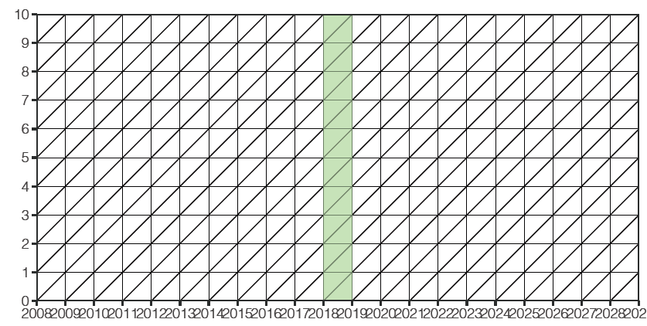
May 2019
March 2020
January 2021

Slide 29
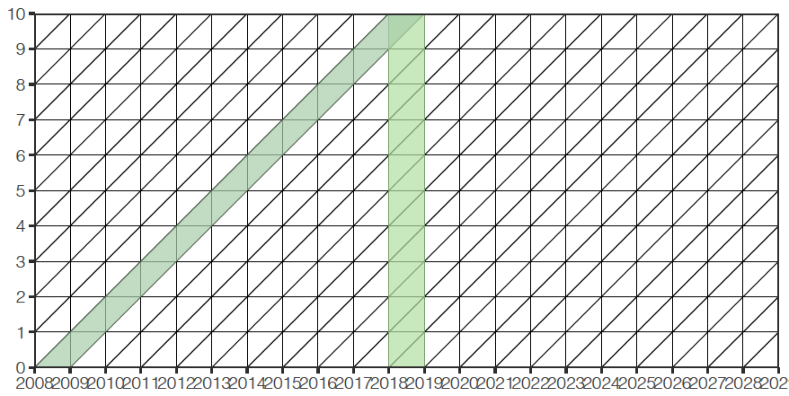
May 2019
March 2020
January 2021

Slide 30
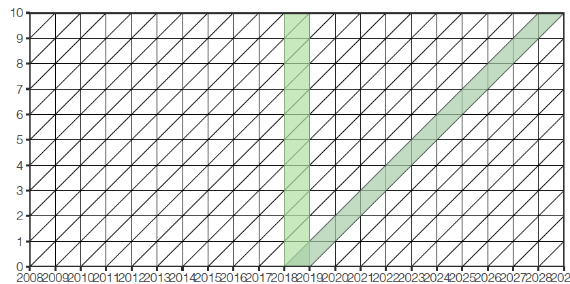
May 2019
March 2020
January 2021

Slide 31
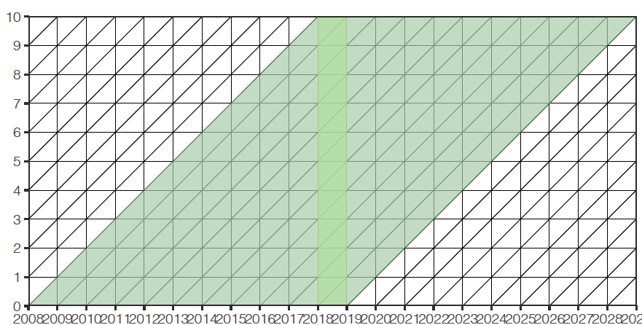
May 2019
March 2020
January 2021

Slide 32
Covid and Preterm Birth

Slide 33
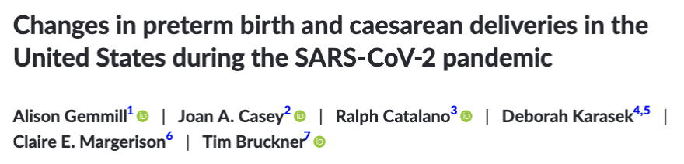
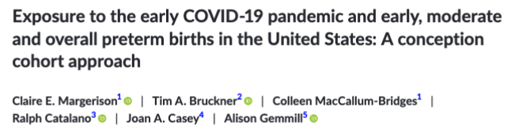
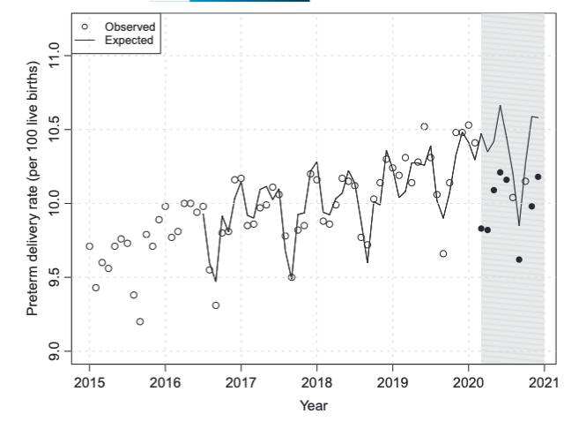
Unexpected reduction in preterm birth in 2020
We detected a 5-6% reduction in preterm births.
Exposure to the early COVID-19 pandemic may have promoted longer gestation among close-to-term pregnancies and/or reduced risk of later preterm delivery among gestations exposed in the first trimester.

Slide 34
Covid and Fertility
Work with Jenna Nobles (lead), Florencia Torche, and Sungsik Hwang

Slide 35
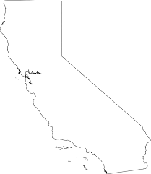
Data
California birth certificate data from January 2014 through November 2022
12% of births in the US
39% Hispanic, 35% white, 15% Asian or Pacific Islander, 5% Black, 4% multiracial, <1% Native American/Alaskan Native)

Slide 36
Methods
Interrupted Time Series models w/ monthly birth data
ARIMA/Box-Jenkins models used to estimate the counterfactual using data from Jan 2014 – Feb 2020
“Effects” are estimated by examining the deviation between expected (from counterfactual) and observed in the COVID period
Examine heterogeneity by maternal age, parity, race/ethnicity, nativity, education (stratified time-series models)

Slide 37
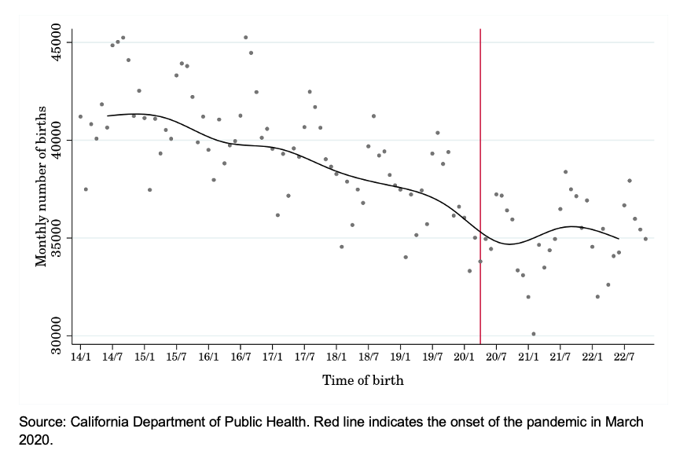
Births in California by month, 2014-November 2022

Slide 38
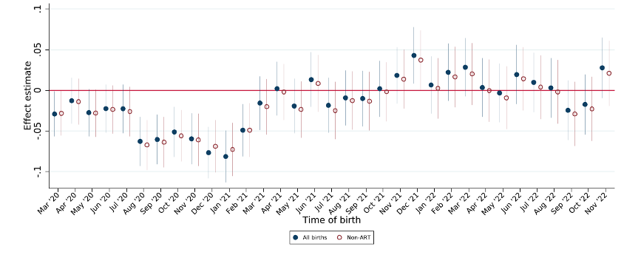
Proportional deviation in California birth counts by month: all births, and births without Assisted Reproductive Technology, March 2020 – Nov 2022

Slide 39
What if you have comparison groups?
Comparative interrupted time series
Bayesian structural time series (Causal Impact package in R)
Synthetic control method (AugSynth package in R)
Important that control is theorized to be unaffected!

Slide 40
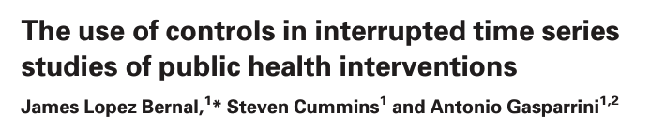
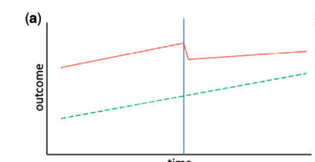
Comparative interrupted time series
Use a comparison population that is theorized to be unaffected by the event
Similar to difference-in-difference designs
Intervention and control groups may exhibit similar autocorrelation, but need to account for any further autocorrelation in intervention group that remains after adjustment for controls

Slide 41
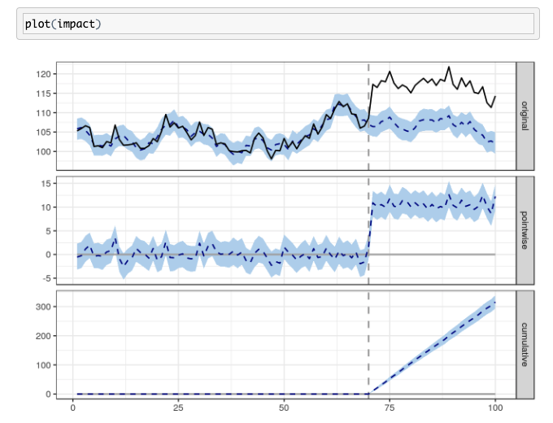
Bayesian Structural Time Series
See CausalImpact Package in R for a useful tutorial

Slide 42
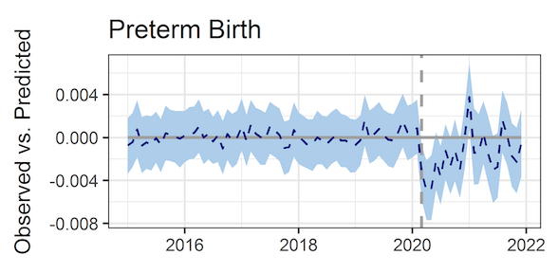
CausalImpact results for preterm birth in US

Slide 43
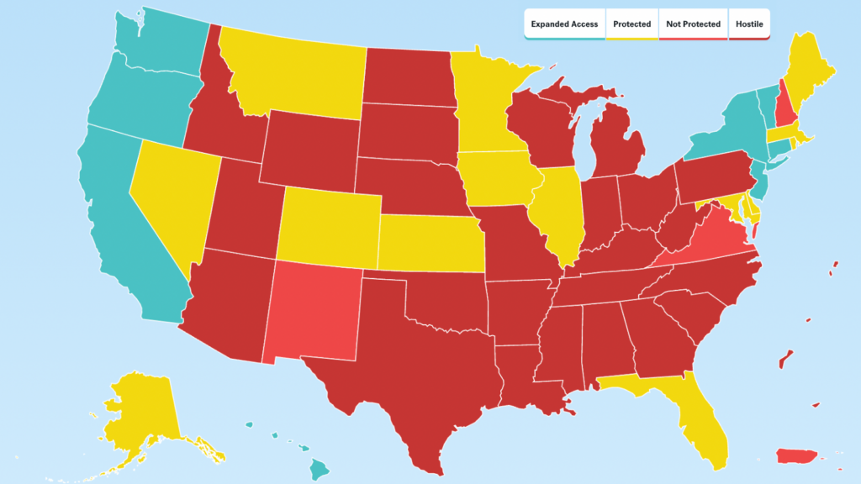
Synthetic Control methods
Good to use when you have one intervention site with multiple comparison sites

Slide 44
Synthetic control methods
1) Build a “synthetic comparison group” by taking a weighted average of other similar “donor” units so that our synthetic comparison group is “as much like” our “treatment” unit as possible before the policy change or event occurred. and then
2) Use the observed outcome trajectory of our synthetic comparison group to represent the counterfactual outcome trajectory for our treatment unit.
See slides from Elizabeth Stuart: https://ww2.amstat.org/meetings/ichps/2020/onlineprogram/ViewPresentation.cfm?file=306613.pdf

Slide 45
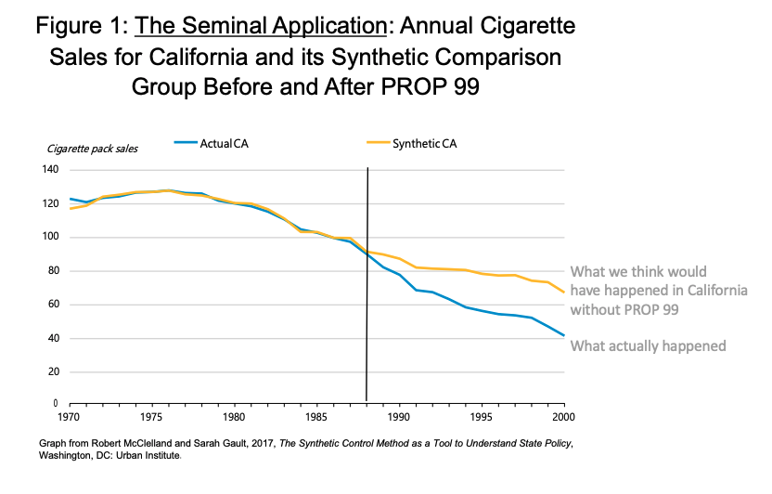

Slide 46
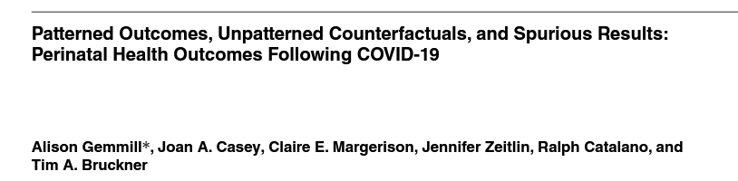
Conclusions
Lots of different ways to model counterfactuals using time series data!
If using monthly or weekly data, make sure you check you always check residuals for temporal autocorrelation
Using ACF and PACF
If autocorrelation is still present, iterate and/or adapt model

